Slide 1
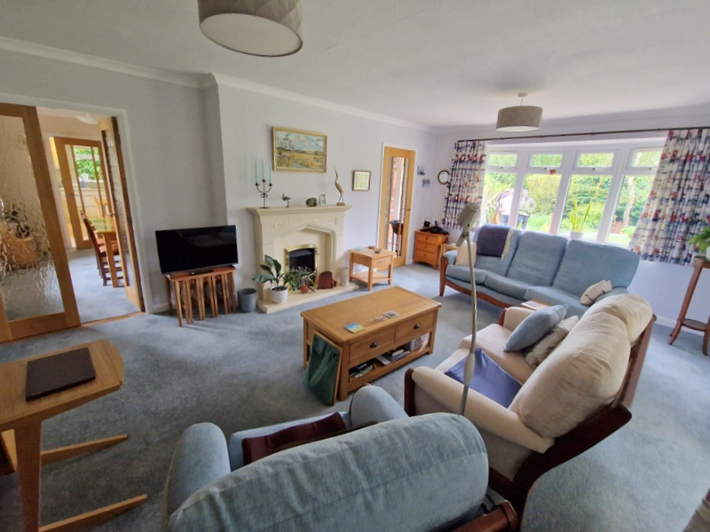
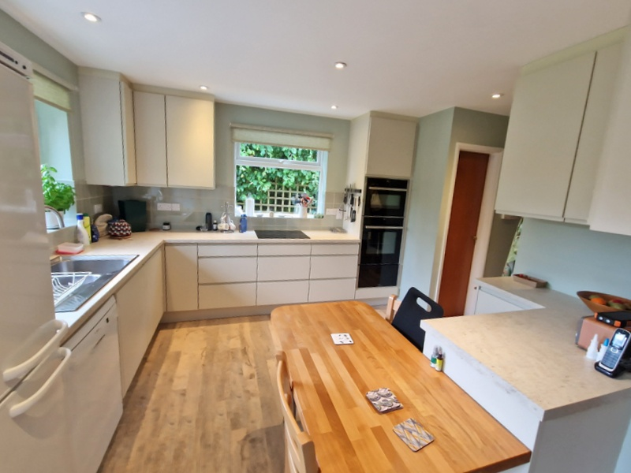
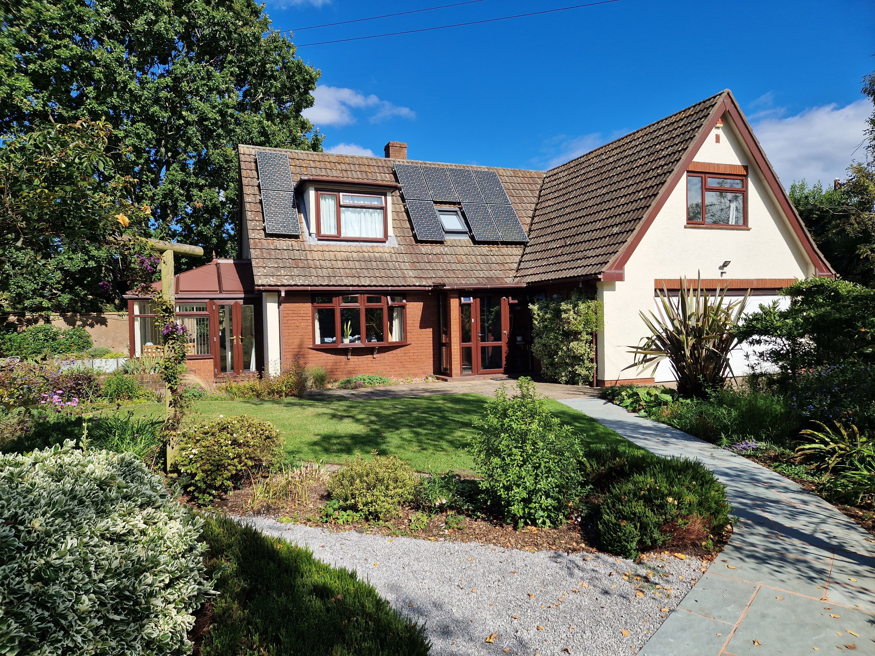
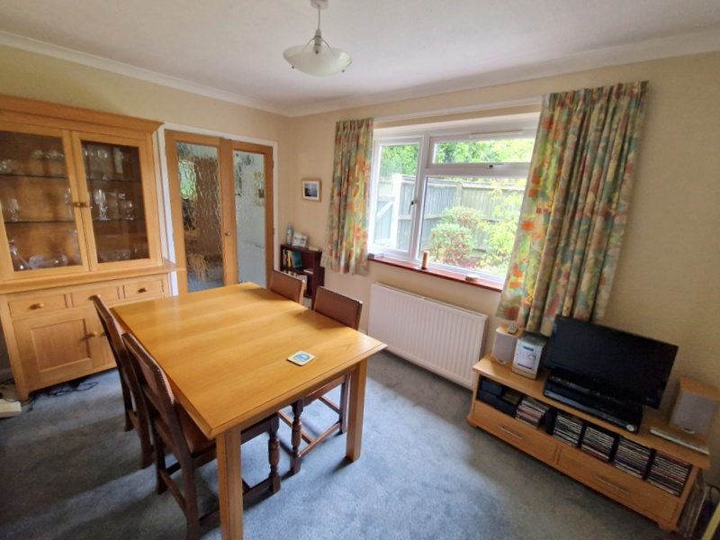
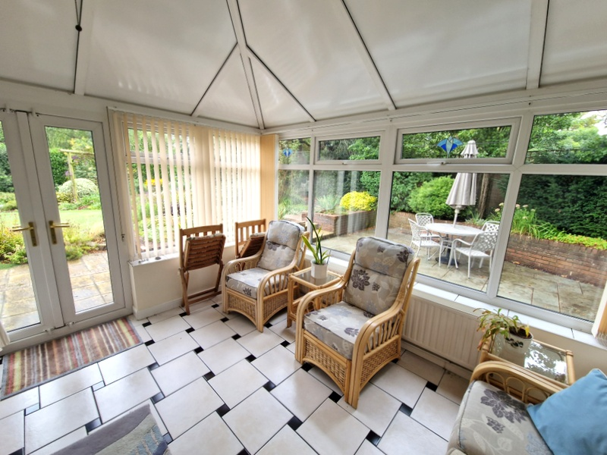
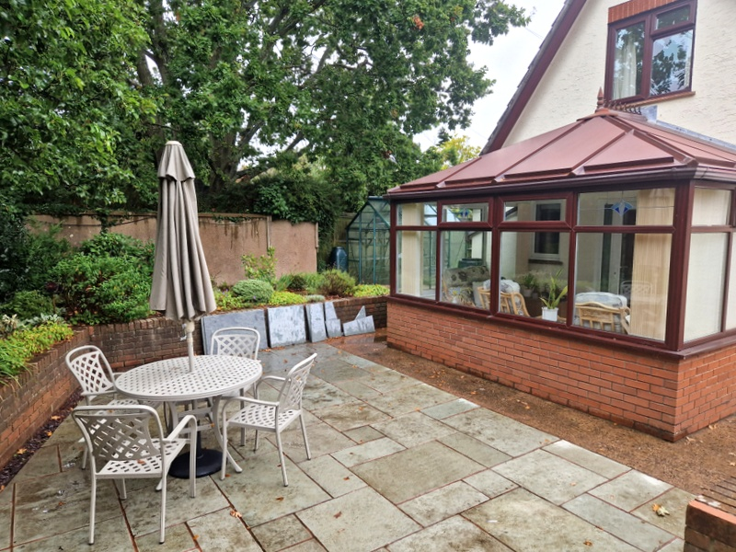
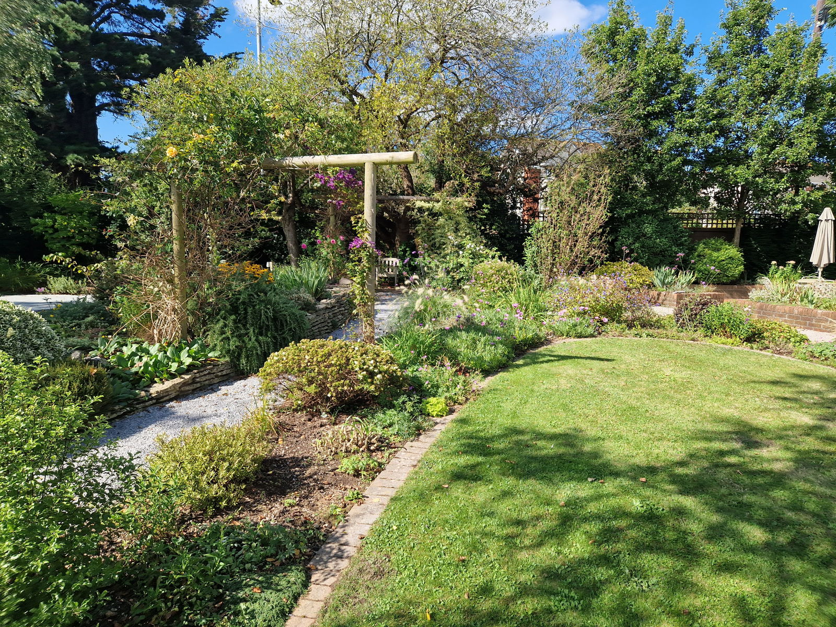
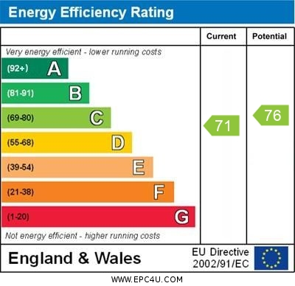
www.pennys.net
44a Salterton Road, Exmouth, EX8 2EJ
GUIDE PRICE £695,000
TENURE Freehold
A Most Attractive Detached House Standing In Beautiful Gardens With Ample Parking And Double Garage
Deceptively Spacious Accommodation * Lounge * Double Glazed Conservatory * Separate Dining Room * Stylish Modern Kitchen/Breakfast Room * Ground Floor Shower Room/Wc With Sauna * Three First Floor Bedrooms * Bathroom/Wc * Gas Central Heating Via Modern Boiler * Owned Solar Panels Producing An Annual Income * Double Glazed Windows * Superb Gardens * Ample Parking And Large Garage * Convenient Location * Viewing Strongly Recommended
Pennys Estate Agents Limited for themselves and for the vendor of this property whose agents they are give notice that:- (1) These particulars do not constitute any part of an offer or a contract. (2) All statements contained in these particulars are made without responsibility on the part of Pennys Estate Agents Limited. (3) None of the statements contained in these particulars are to be relied upon as a statement or representation of fact. (4) Any intending purchaser must satisfy himself/herself by inspection or otherwise as to the correctness of each of the statements contained in these particulars. (5) The vendor does not make or give and neither do Pennys Estate Agents Limited nor any person in their employment has any authority to make or give any representation or warranty whatever in relation to this property.
PENNYS ESTATE AGENTS
2 Rolle House, Rolle Street, Exmouth, Devon, EX8 2SN
Tel: 01395 264111 EMail: help@pennys.net

Slide 2
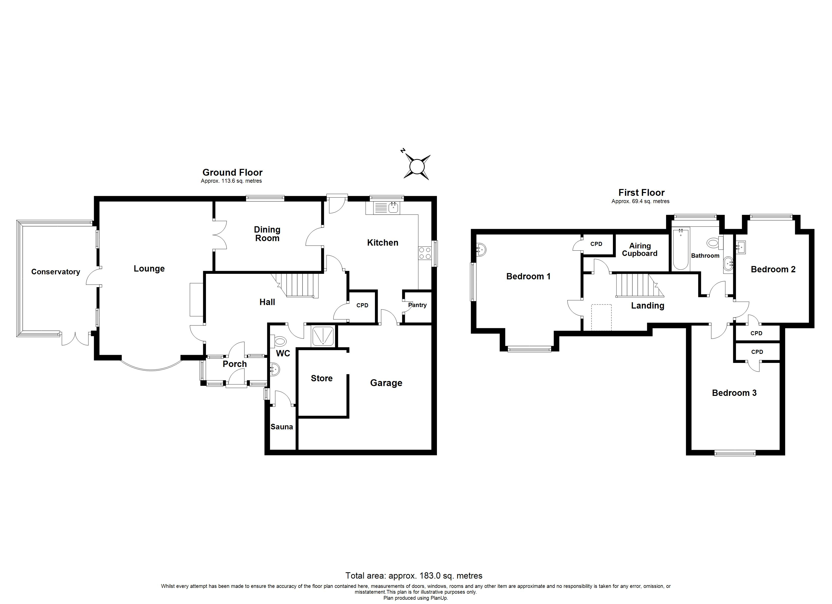
44a Salterton Road, Exmouth, EX8 2EJ
THE ACCOMMODATION COMPRISES: uPVC double glazed front door to:
ENTRANCE PORCH: With courtesy light, inner uPVC door with pattern window inset with matching picture window side screens giving access to:
RECEPTION HALL: A spacious entrance to the property with feature engineered oak flooring, radiator, staircase rising to first floor landing, useful understairs space used as home office, good size coats cupboard, dado rail, coved ceiling.
GROUND FLOOR SHOWER ROOM/WC/SAUNA: Shower cubicle with shower splash screen door with Mira shower unit in tiled cubicle, wash hand basin with tiled splash back, WC with push button flush, radiator, electric heated towel rail, uPVC double glazed window with patterned glass. SAUNA with pine clad walls and pine slatted bench seats, lighting.
LOUNGE: 5.79m x 3.91m (18'11" x 12'10") Spacious room with uPVC double glazed Oriel style window overlooking the gardens, attractive stone fireplace housing living flame coal gas fire, two radiators, TV point, coved ceiling, two uPVC double glazed windows overlooking the conservatory, uPVC double glazed door giving access to:
CONSERVATORY: 3.66m x 2.74m (12'0" x 9'0") A delightful addition to the accommodation with uPVC double glazed windows and insulated roof overlooking the beautifully tended gardens, uPVC double glazed doors opening onto the gardens, tiled flooring, radiator, electric fan light.
DINING ROOM: 4.01m x 2.64m (13'2" x 8'8") (access from both the lounge and the kitchen) uPVC double glazed window overlooking the rear garden, radiator, coved ceiling.
KITCHEN/BREAKFAST ROOM: 4.14m x 3.3m (13'7" x 10'10") plus doorway recess. Well appointed and stylish modern kitchen with a range of patterned work surfaces with inset single drainer one and a half bowl sink unit, tiled surrounds, range of cupboards, incorporating two carousel units, pull out refuse drawer and drawer units, space for dishwasher beneath worktops, inset induction hob, built-in double oven and warming drawer, range of wall mounted cupboards, space for upright fridge/freezer, solid wood breakfast bar area, uPVC double glaze windows to side and rear aspects, uPVC double glazed door giving access to the rear garden, walk-in larder cupboard with shelving and light, internal door to the GARAGE. Recessed ceiling led spotlighting.
FIRST FLOOR LANDING: Part sloping ceilings, double glazed velux window, dado rail radiator, walk-in airing cupboard housing water cylinder with shelving.
BEDROOM 1: 4.19m x 3.89m (13'9" x 12'9") A bright dual aspect room with part sloping ceilings, two sets of uPVC double glazed windows overlooking the gardens, TV point, pedestal wash hand basin with tiled splashback, radiator, walk-in wardrobe.
BEDROOM 2: 4.88m x 3.28m (16'0" x 10'9") maximum overall measurement. A good size double bedroom with uPVC double glazed window to front aspect, part sloping ceilings, access to eaves storage space, TV point, built-in wardrobe.
BEDROOM 3: 3.89m x 2.97m (12'9" x 9'9") Another good size double bedroom with vanity wash hand basin with tiled splashback, part sloping ceilings, radiator, uPVC double glazed window to rear aspect, TV point.
BATHROOM/WC: 2.74m x 2.41m (9'0" x 7'11") With bath, wash hand basin set in display surface with cupboards and WC with push button flush, further fitted cupboards with display surface over, mirror fronted medicine cabinet with display light, access to loft space via roof ladder, chrome heated towel radiator, attractive extensively tiled walls, uPVC double glazed window with patterned glass.
OUTSIDE: The property is approached via Cranford View, via a good size driveway offering parking for several cars and leading to a DOUBLE GARAGE. There are beautifully tended gardens to the front of the property offering a high degree of privacy and seclusion comprising well stocked flower and shrub beds offering an array of colour with stone and patio pathways, circular patio sun terrace. To the side of the property is a further patio sun terrace ideal for outside entertaining with raised flower beds. Leading through to the rear garden where there is a GREENHOUSE and gate giving access to a further enclosed rear garden area with raised pebble flower and shrub beds. Outside cold water tap. Substantial POTTING SHED 82.62m x 2.13m (8'7" x 7'0") with power and light connected. A side pathway and gate gives access back around to the front of the property.
GARAGE: 4.83m x 4.78m (15'10" x 15'8") narrowing to 2.74m (9’0"). Up and over door, divided into two areas, housing Gloworm gas boiler for hot water and central heating. Solar heating unit. Electric consumer unit. SECOND AREA: 2.44m x 1.88m (8'0" x 6'2") This is fitted with plumbing for automatic washing machine, shelving and light.
Mortgage Assistance: We are pleased to recommend Meredith Morgan Taylor, who would be pleased to help no matter which estate agent you finally buy through. For a free initial chat please contact us on 01395 264111 to arrange an appointment. Your home may be repossessed if you do not keep up repayments on your mortgage. Meredith Morgan Taylor Ltd is an appointed representative of Openwork Limited, a trading style of Openwork Ltd which is authorised and regulated by the Financial Conduct Authority (FCA).
FLOOR PLAN:

